Slide 1
Big Mountain
Proper pricing for an elite Ski Resort

Slide 2
Problem/ Data set
You have a top of the line Ski resort and you are charging industry average ticket prices.
How do we better measure the value of key facilities in Big Mountain in order to accurately price Tickets before next season?
We have a great Data set that specifies 27 different features of 330 different ski resorts.
Resorts are split into Regions and States which can help us to determine a good price based on northwestern ski lodges
The Data set gives us ticket prices for the majority of the ski resorts so we can estimate an optimized Big mountain ticket price based on its features.

Slide 3
Recommendation
We recommend an increase of $10 per ticket and a possible decrease in the number triple and double runs to save costs.
We make this recommendation based on the modelling we have done to isolate the most important features and use them to predict the optimal price of Big Mountain tickets

Slide 4
Most important features
vertical_drop
Snow Making_ac
total_chairs
fastQuads
Runs
LongestRun_mi
trams
SkiableTerrain_ac

Slide 5
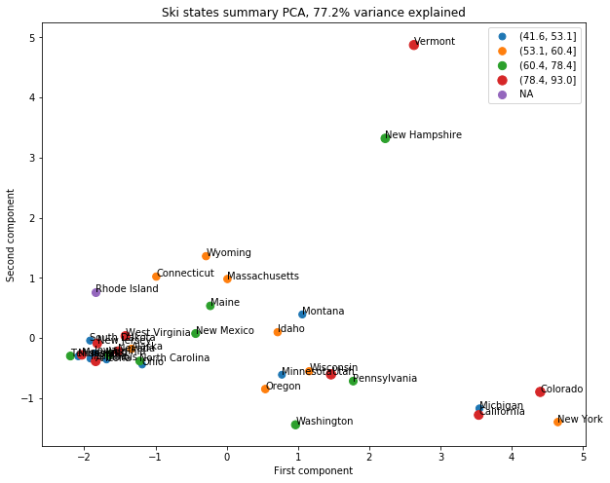
Features of the Data set
In this graph we look at how the state of each resort effected the overall price. The State in which the resort is placed accounts for 77.2% of the variance so this is a very important figure. The color code tells us which quartile the price lies. As you can see the price quartile does not seem to affect how many resorts per state there are and what the skiable area is.

Slide 6
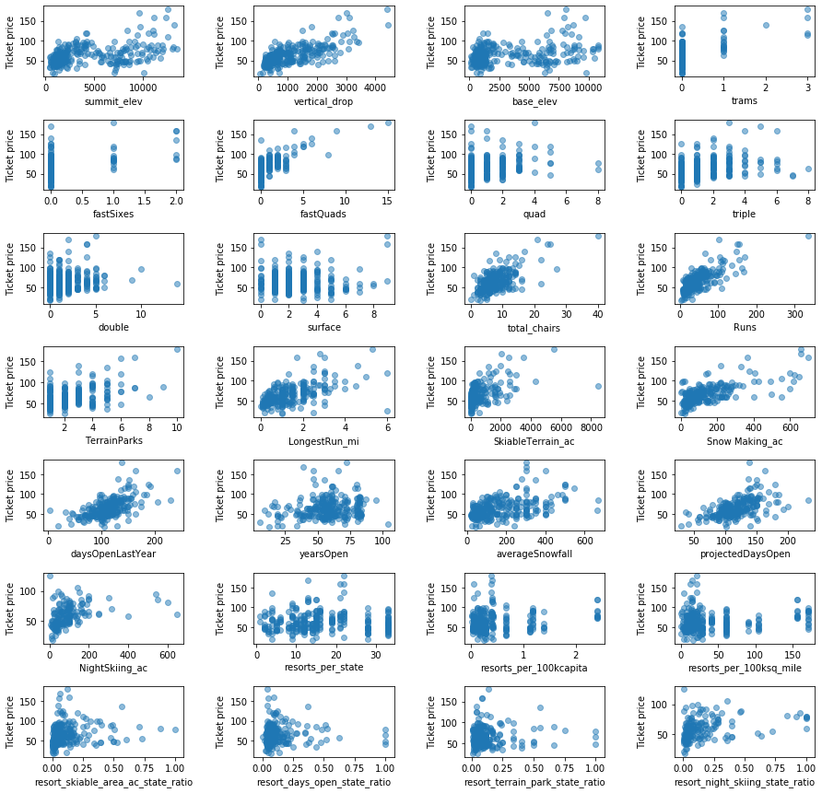
Features
The graph here looks at the all the different features of the resort and their relation to ticket price.
As you can see there are a few that have no relation however some have obvious correlation.
This helps us to focus on summit elevation, vertical drop, number of runs, fast quads and base elevation.

Slide 7
Metrics
Average price of training Data without a predictive model(strictly the average)= 63.811
Mean average error of price(between the training and testing data)= 19.1361
Mean Squared Error (between the training and testing data) =581.4365
R-squared for the initial model training set vs testing set. = 0.8145(training). 0.73132(testing)

Slide 8
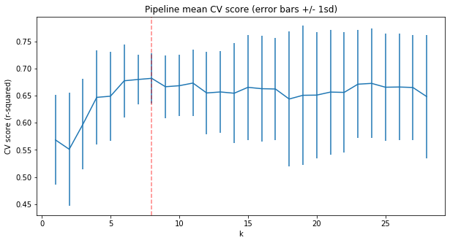
CV score
This graph shows us the optimal number of features to use in our model. We use the features with the the highest r squared. If we use too may features we risk overfitting.
The model shows us that R squared improves up to 8 features and then declines. The parallel lines tell us the amount of variation that takes place on the testing data.

Slide 9
Pricing Big Mountain
Big Mountain Resort modelled price is $95.87, actual price is $81.00.
Even with the expected mean absolute error of $10.39, this suggests there is room for an increase.
The above gives us great insight because our model is telling us that we could increase ticket pricing for the various amenities of Big Mountain resort.

Slide 10
Conclusion
We find that the most important features of big mountain are the 8 primary features of the model. After optimizing our model we have discovered that we can increase ticket pricing for big mountain. My suggestion would be an increase of $8.50 per Adult and close the 5 least popular runs at the resort.
We believe this will increase your ticket revenue and still maintain the vast majority of your business.

